Slide 1
Telecom Churn Case Study
Mustafa

Slide 2
Agenda
Problem Statement
Analysing Approach
Data Understanding and Cleaning
Data Preparation and Model building
SUMMARY

Slide 3

Introduction
Customers in the telecom sector have access to a variety of service providers and can actively switch from one operator to another. The telecoms business has an average annual churn rate of 15 to 25 percent in this fiercely competitive market. Customer retention has now surpassed customer acquisition in importance due to the fact that it is 5–10 times more expensive to gain new customers than to keep existing ones. Retaining highly profitable consumers is the top business objective for many established operator. Analysis needs to be done to predict models to find customers who are likely to leave Analysis needs to be done for Prepaid and Postpaid model. The Churn is more critical for Prepaid Customers in India and Southeast Asian Market. There are 2 types of churn Revenue based churn and Usage based churn. We need to do analysis on the usage based definition to define churn. The business objective is to predict the churn in the last (i.e. the ninth) month using the data (features) from the first three months. There are 3 phases of customer Good, Action and Churn. Churn is defined during the last phase as mentioned and data is discarded corresponding to the tag churned

Slide 4
Analyses Approach
1.Reading and understanding the data
2.Data Cleaning
3.Filtering the High Value Customer
4. Defining Target Variable
5. Data Preparation
6. Data Modelling
I. Creating dummies II. Train- Test split III. Handling Class Imbalance
7. Logistic Regression
I RFE technique for variable selection
II. Model Building
III. Model Evaluation – Accuracy, Specificity, Sensitivity
IV. Predicting on test data
V. Hyperparameter Tuning
8. Model Selection

Slide 5
Data Understanding and Cleaning
The dataset telecom_churn_data.csv has around 99999 entries with 226 attributes
The missing values are imputed accordingly for data recharge ,count recharge columns
Dropping columns/rows with high missing values.
Feature Engineering to create new columns

Slide 6
Filtering the High Value Customers and defining Target Variable
Imputing the attributes having missing values with advanced imputation technique like `KNNImputer’.
Two Types of Churn Usage Based churn “Completely inactive Customers” and Revenue Based Churn “Partial Inactive Customers”
9th month is the churn phase , Churn variable is derived using total_ic_mou_9`,`total_og_mou_9`,`vol_2g_mb_9` & `vol_3g_mb_9` attributes
Check for correlation of the independent variables and understand their dependencies

Slide 7
Data Preparation
Deriving New Variables
Verifying correlation between target variable (Sale Price) and other variable in the data frame.
Visualization of data to view the churn rate
Model Building
Creating Dummy Variables for categorical variables
Handling Class imbalance, using SMOTE method.
Features are selected using RFE
Model is formed using Logistic Regression
By checking p value and vif values, features are dropped and optimal model is obtained
Parameters like Accuracy, Specificity, Sensitivity are calculated
Predictions are applied on Test data and evaluated

Slide 8
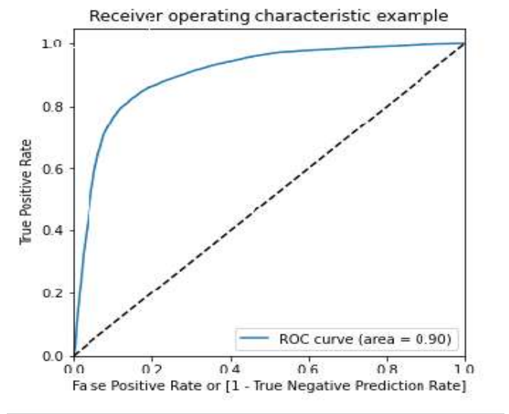
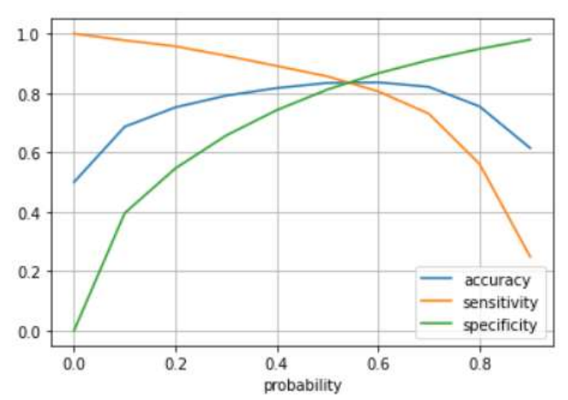
Model evaluation –ROC Curve
Model Evaluation-Accuracy
Accuracy : 83.6
Sensitivity : 83.6
Specificity : 83.6
From the above graph,
we can see the optimum cutoff is
around 0.54
Accuracy : 83
Sensitivity :80.0
Specificity :82.9
As the model created is based on a sensitivity model, i.e. the True positive rate is given more importance as the actual and prediction of churn by a customer
Model Evaluation on Test data

Slide 9
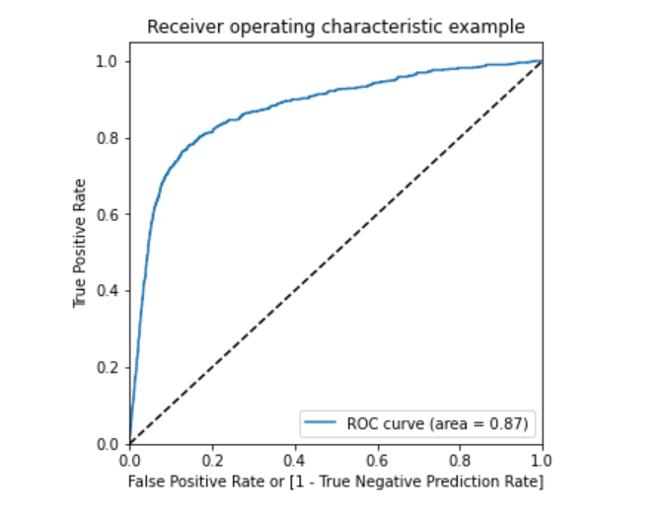
Model evaluation –ROC Curve
PCA and SVM on Logistics Regression
The Accuracy of the logistic regression model in train with PCA: 81.8
Accuracy of the logistic regression model in test with PCA: 75.4
SVM Analysis Below.
Accuracy 78.1
Precision 23.3
Recall 74.3
Hyper parameter Tuning
The AUC score for train Data Frame is 0.90 and the test Data Frame is 0.87.This model can be considered as a good model.
The Test score is 86.9 corresponding to hyper parameters {'C': 1000, 'gamma': 0.01}
Random Forest Analysis Below.
Accuracy 93.2
Precision 73.8
Sensitivity/Recall 24.8
Roc_auc_score 62.0

Slide 10
Model Selection
The best model out of all is Logistic regression model which gives recall of 81% and ROC value of 0.89
Inference
Accuracy, Sensitivity and Specificity are in similar range for Train and Test data
Std Outgoing Calls and Revenue Per Customer are strong indicators of Churn.
Local Incoming and Outgoing Calls for 8th Month and avg revenue in 8th Month are the most important columns to predict churn.
Customers with tenure less than 4 yrs are more likely to churn. Max Recharge Amount is a strong feature to predict churn.
Logistic Regression produced the best prediction results after tackling Class Imbalance

Slide 11
Conclusion
Std Outgoing Calls and Revenue Per Customer are strong indicators of Churn.
Local Incoming and Outgoing Calls for 8th Month and avg revenue in 8th Month are the most important columns to predict churn.
Customers with tenure less than 4 yrs are more likely to churn.
Max Recharge Amount is a strong feature to predict churn.
Logistic Regression produced the best prediction results after tackling Class Imbalance.

Slide 12
THANK YOU

